Slide 1

A Project Report on
‘Dental EV (Web Apllications) ’
(Smile Guard)
Submitted by
Parmar vikram (2204030100795)
Solanki satish (2204030101352)
Solanki happy(2204030101342)
Soni Vrajesh (2204030101373)
Under the Guidance Of (Arpita Mathur)
Semester-6
Department of Computer Application
Silver Oak College of Computer Application
SILVER OAK UNIVERSITY,
Ahmedabad-382481, INDIA NOVEMBER 2024-2025

Slide 2
CERTIFICATE
This is to certify that
Mr./Ms... Parmar vikram
with enrollment no. ... 2204030100795…
from Semester . 6 .Div. I. has successfully completed his/her viva review examination in the Major Project (2040233392) from
the Department of Computer Application during academic year . 2024 - 2025
Date of Submission: .02-11-2025. Staff In charge: ...........................
Head of Department: ...........................................

Slide 3
CERTIFICATE
This is to certify that
Mr./Ms... Solanki satish
with enrollment no. ... 2204030101352…
from Semester . 6 .Div. I. has successfully completed his/her viva review examination in the Major Project(2040233392) from
the Department of Computer Application during academic year . 2024 - 2025
Date of Submission: .02-11-2025. Staff In charge: ...........................
Head of Department: ...........................................

Slide 4
CERTIFICATE
This is to certify that
Mr./Ms... Solanki happy
with enrollment no. ... 2204030101342…
from Semester . 6 .Div. I. has successfully completed his/her viva review examination in the Major Project (2040233392) from
the Department of Computer Application during academic year . 2024 - 2025
Date of Submission: .02-11-2025. Staff In charge: ...........................
Head of Department: ...........................................

Slide 5
CERTIFICATE
This is to certify that
Mr./Ms... Soni Vrajesh
with enrollment no. ... 2204030101373…
from Semester . 6 .Div. T. has successfully completed his/her viva review examination in the Major Project (2040233392) from
the Department of Computer Application during academic year . 2024 - 2025
Date of Submission: .02-11-2025. Staff In charge: ...........................
Head of Department: ...........................................

Slide 6
TABLE OF CONTENTS
Contents
Introduction
Existing System
Need for the New System
Objective of the New System
Problem Definition
Core Components
Project Profile
Assumptions and Constraints
Advantages and Limitations of the Proposed System
Requirement Determination & Analysis
Requirement Determination
Targeted Users
System Design
Use Case Diagram
Class Diagram
Interaction Diagram
Activity Diagram

Slide 7
3.5.Data Dictionary
4. Development
4.5.Coding Standards
1.2. Screen Shots
Proposed Enhancements
Conclusion
Bibliography

Slide 8
INTRODUCTION :
Existing System Describe how music management or playlist creation is handled currently and the limitations of these systems.
Need for the New System Explain why there is a need for your Music Playlist Manager. Discuss problems with current solutions.
Objective of the New System State the goals of the project (e.g., to create a user-friendly, feature-rich playlist manager).
Problem Definition Define the specific problems your project aims to solve.
Core Components Highlight the main features, such as playlist creation, song sorting, shuffle, repeat, etc.
EXISTING SYSTEM
Requirement Determination List functional and non-functional requirements for the system (e.g., song playback, responsive design).
Targeted Users Define the user base (e.g., music enthusiasts, general users).
NEED FOR THE NEW SYSTEM
Use Case Diagram Illustrate the system's functionality and interactions with users.
Class Diagram If object-oriented programming is involved, display the classes and their relationships.
Interaction Diagram Show how the system components interact (e.g., user selects a song, the system plays it).
Activity Diagram Diagram the flow of operations, such as playlist creation or song playback.

Slide 9
PROBLEM DEFINITION
Identify the problems your system aims to solve:
Difficulty in organizing and managing music efficiently.
Limited personalization in existing playlist systems.
No offline, lightweight solution available.
CORE COMPONENTS
List the core functionalities your system will offer:
Add and remove songs from playlists.
Play/pause, shuffle, repeat, and loop options.
Volume control and seek bar.
Custom playlist creation and editing.
Saving playlists for future use.
PROJECT PROFILE
Include details like:
Technologies Used: HTML, CSS, JavaScript, Flask.
Team Members: List of contributors (if any).
Timeline: Estimated time to complete the project.
Platform: Browser-based application.
ASSIMPTIONS AND CONSTRAINTS
Assumptions:
Users have MP3 files ready to use.
The system will run on modern web browsers.
Constraints:
System performance may depend on the user's device.
Local storage size limits the number of songs/playlists stored.

Slide 10
1.8. ADVANTAGES AND LIMITATION OF THE PROPOSED SYSTEM
Advantages:
Fully customizable playlists.
Offline functionality using local storage.
Simple, user-friendly interface.
Limitations:
No real-time collaboration between users.
Limited to the capabilities of the user's device and browser.
REQUIREMENT DETERMINATION & ANALYSIS :
List the functional and non-functional requirements:
Functional Requirements:
Create, edit, and delete playlists.
Play and control songs.
Save playlists locally.
Non-Functional Requirements:
Responsive design for various screen sizes.
Smooth animations and transitions.
Accessibility for users with disabilities.

Slide 11
2.2. TARGETED USERS
Define the target audience for the system:
Music enthusiasts.
Users looking for a lightweight playlist manager.
Individuals who prefer offline tools.
SYSTEM DESIGN :
USE CASE DIAGRAM
Create a diagram showing interactions between the system and the user. Examples:
User logs in → selects songs → creates a playlist → plays songs.

Slide 12
3.2. CLASS DIAGRAM
If using object-oriented programming, show the relationships between entities. Example classes:
Playlist: Stores playlist name and songs.
Song: Represents individual songs with properties like title, artist, and duration.
User: Handles user preferences and saved playlists.
<!DOCTYPE html>
<html lang="en">
<head>
<meta charset="UTF-8">
<meta name="viewport" content="width=device-width, initial-scale=1.0">
<title>Music Playlist Manager</title>
<link rel="stylesheet" href="styles.css">
</head>
<body>
<div class="container">
<h1>Music Playlist Manager</h1>
<!-- Search bar -->
<input type="text" id="searchBar" placeholder="Search for a song..." onkeyup="searchSongs()" aria-label="Search songs">
<!-- Sort buttons -->
<div class="controls">
<button onclick="sortPlaylist('alphabet')">Sort Alphabetically</button>
<button onclick="sortPlaylist('duration')">Sort by Duration</button>
</div>

Slide 13
INTERACTION DIAGRAM
Illustrate the interactions between different components. Example flow:
User clicks "Add Song" → System displays file selection dialog → User selects song → System adds the song to the playlist.
.
ACTIVITY DIAGRAM
Draw a step-by-step process of system operations. Example:
User opens the application.
User creates a new playlist.
User adds songs to the playlist.
User plays songs from the playlist.
User saves the playlist.

Slide 14
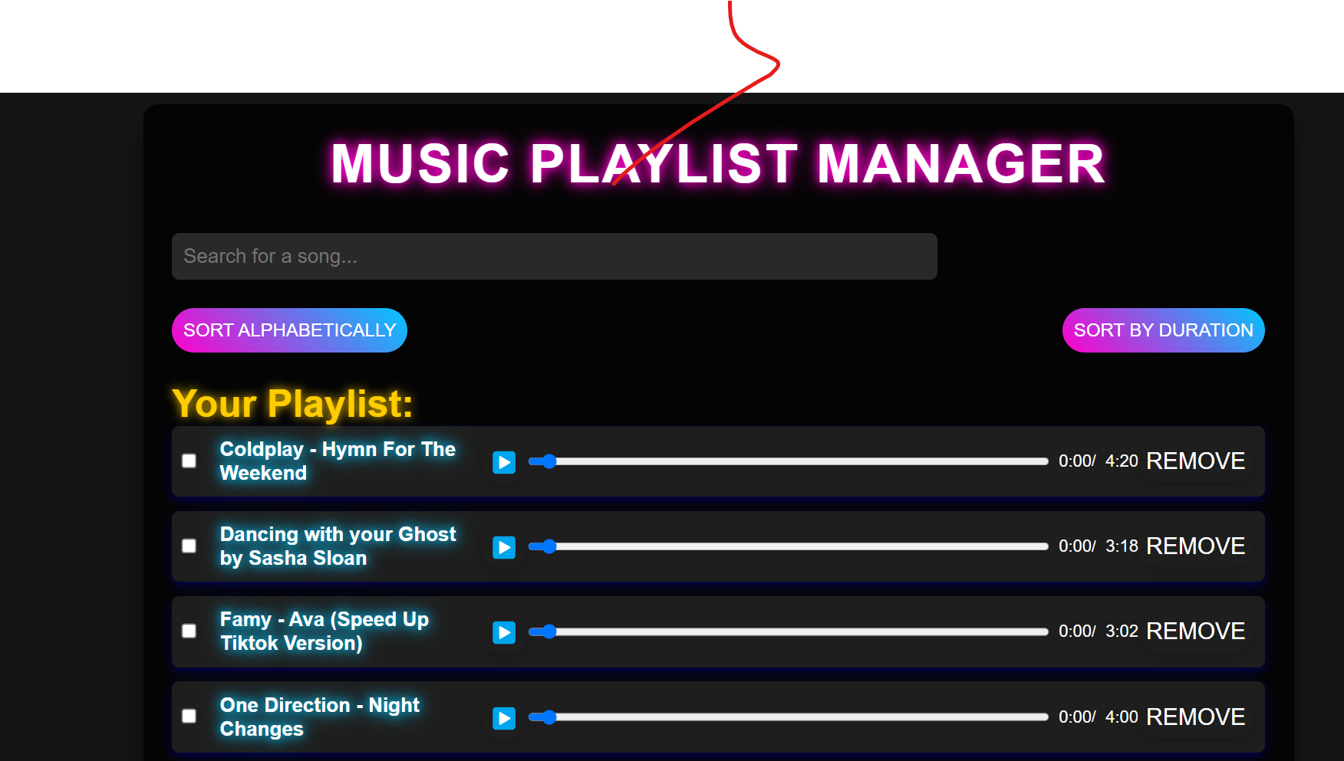
CONCLUSION :
In conclusion, the Music Playlist Manager project is a comprehensive and user-friendly solution for managing and enjoying music playlists. It addresses the limitations of existing systems by providing features such as customizable playlists, song sorting, shuffle and repeat options, and persistent storage using modern web technologies. This project showcases the power of integrating HTML, CSS, JavaScript, and frameworks like Flask to deliver a robust application that meets the needs of diverse users.
The system not only improves the user experience but also enhances productivity by allowing users to organize their music efficiently. With additional features like responsive design, accessibility support, and modern CSS effects, the project sets a benchmark for lightweight, browser-based applications.
Future improvements could include cloud-based storage for sharing playlists, AI-based song recommendations, and collaborative playlist creation. By continuously evolving and incorporating user feedback, this Music Playlist Manager has the potential to become a reliable and indispensable tool for music enthusiasts.

Slide 15
Technical Details of Project
Abstract :
This project aims to create an interactive music player using HTML, CSS, JavaScript, and Flask. The application allows users to create custom playlists, control music playback, and save their preferences. The project focuses on delivering a rich user experience with modern UI/UX design.
Introduction :
The Music Playlist Manager is a web-based application designed to manage and play music files. It provides a modern, responsive interface with advanced features for creating and managing custom playlists.
Objective :
Create an interactive music player interface.
Implement custom playlist creation and management.
Provide advanced music controls (play, pause, shuffle, loop).
Ensure responsive design for various devices.
Enable persistent playlist saving using localStorage

Slide 16
6. References :
1. HTML, CSS, and JavaScript Documentation
2. Flask Framework (Python) Documentation
3. Online Tutorials and Resources for Web Development

